Slide 1
Midterm #1

Slide 2
A business case
Audiobooks

Slide 3
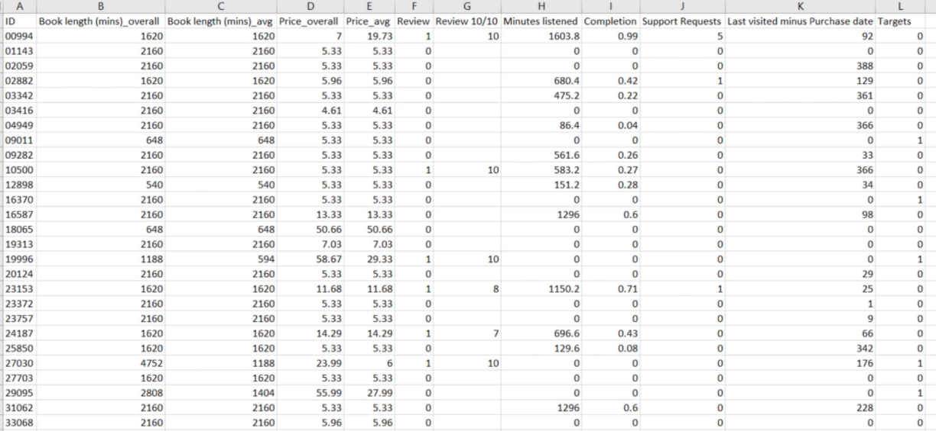
The dataset
Notes:
There would be no text in the real dataset! Because we want only numbers.

Slide 4
The dataset
Missing Data!
Notes:
There would be no text in the real dataset! Because we want only numbers.

Slide 5
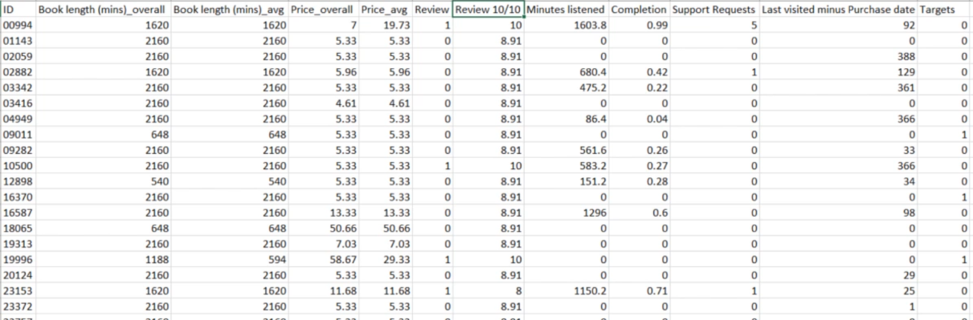
The dataset
Missing Data!
We add the average
Notes:
8.91 is the average, because we want to fill the empty spots. A customer below that value is unlikely to buy again

Slide 6
The dataset
Total minutes listened / book_length_overall
Notes:
Basically, how much of the book has been read

Slide 7
The dataset
The difference between the last time a person interacted with the platform and their first purchase date

Slide 8
The dataset
After 2 years period (data collected), this Boolean tells if the user bought another book in the following 6 months

Slide 9
Goal
Create a machine learning model that predicts if a customer will buy again from the platform

Slide 10
Steps
Preprocess the data
Balance the dataset
This is crucial! You want the “targets” to be evenly distributed
Divide the dataset in Training, Validation and Testing sets
We want to prevent overfitting
Save the dataset in tensor format [.npz]
Create the machine learning algorithm

Slide 11
Preprocessing example
We will use the sklearn preprocessing library, as it will be easier to standardize the data
You can install it with pip install sklearn

Slide 12
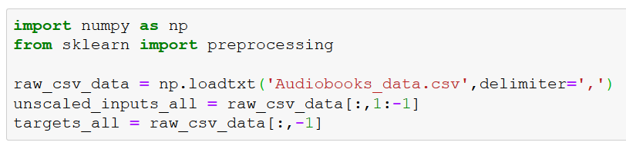
Preprocessing example
[ : , 1 : -1 ]
The first part [ : , indicates that we want to read all the rows (we don’t specify any upper and lower bound before and after the : symbol)
Then, we want the inputs from all columns in the csv, except for the first one 1: (indexed 0) which is just the arbitrary customer IDs that bear no useful information, and the last one :,-1] (which is our targets)
The targets are in the last column
That's how datasets are conventionally organized.
[ : , -1 ] , all rows and all columns but the last one

Slide 13
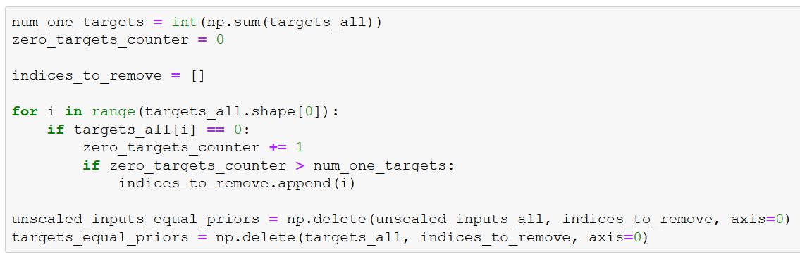
Balancing the dataset

Slide 14
We count how many targets are 1 (meaning that the customer did buy again)
And we set a counter for targets that are 0 (meaning that the customer did not buy again)
Notes:
We use int, because we cannot be sure on the type and we need int

Slide 15
We want to create a "balanced" dataset, so we will have to remove some input/target pairs, and we declare a variable that will do that

Slide 16
We count the number of targets that are 0
And once there are as many 0s as 1s, we mark entries where the target is 0
Notes:
The shape of targets_all on axis = 0 is basically the length of the vector

Slide 17
We create two new variables, one that will contain the inputs, and one that will contain the targets
And we delete all indices that we marked "to remove" in the loop above
Notes:
np.delete deletes an object along an axis

Slide 18
Standardizing the inputs
That's the only place we use sklearn functionality
We will take advantage of its preprocessing capabilities
It's a simple line of code, which standardizes the inputs
At the end of your business case, you can try to run the algorithm WITHOUT this line of code
The result will be interesting…

Slide 19
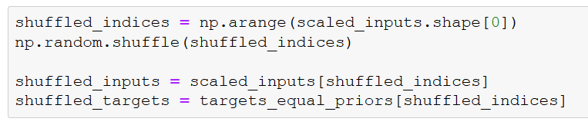
Shuffle the data
When the data was collected it was actually arranged by date
We want to shuffle the indices of the data, so the data is not arranged in any way when we feed it
Since we will be batching, we want the data to be as randomly spread out as possible
We use the shuffled indices to shuffle the inputs and targets
NOTE: It also makes sense to shuffle the indices prior to balancing the dataset
Notes:
np.arange is a method that returns an evenly spaced values withing a given interval
It basically returns an array with the elements in scaled_inputs

Slide 20
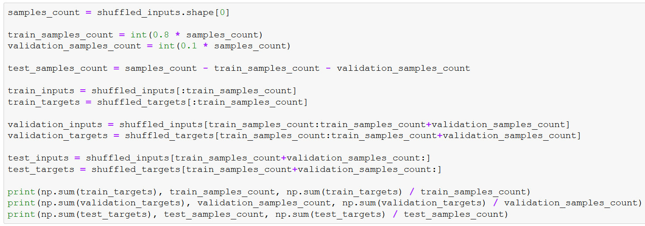
Splitting the data

Slide 21
We count the total number of samples
We count the samples in each subset, assuming we want 80-10-10 distribution of training, validation, and test.

Slide 22
The 'test' dataset contains all remaining data

Slide 23
We create variables that record the inputs and targets for training
In our shuffled dataset, they are the first "train_samples_count" observations

Slide 24
We create variables that record the inputs and targets for validation
They are the next "validation_samples_count" observations, folllowing the "train_samples_count" we already assigned

Slide 25
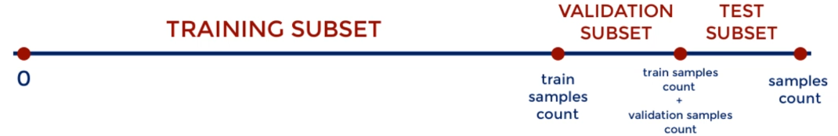
We create variables that record the inputs and targets for test
They are everything that is remaining

Slide 26
We print the number of targets that are 1s, the total number of samples, and the proportion for training, validation, and test.
The output should be close to 50% for all three

Slide 27
We balanced our dataset to be 50-50 (for targets 0 and 1), but the training, validation, and test were taken from a shuffled dataset. Check if they are balanced, too
Note that each time you rerun this code, you will get different values, as each time they are shuffled randomly
Normally you preprocess ONCE, so you need not rerun this code once it is done
If you rerun this whole sheet, the .npzs will be overwritten with your newly preprocessed data

Slide 28
Saving in .npz format
Finally, we save the three datasets in *.npz format

Slide 29
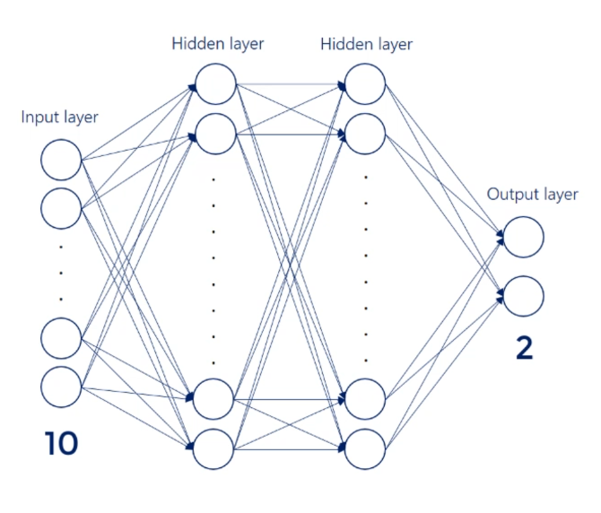

Slide 30
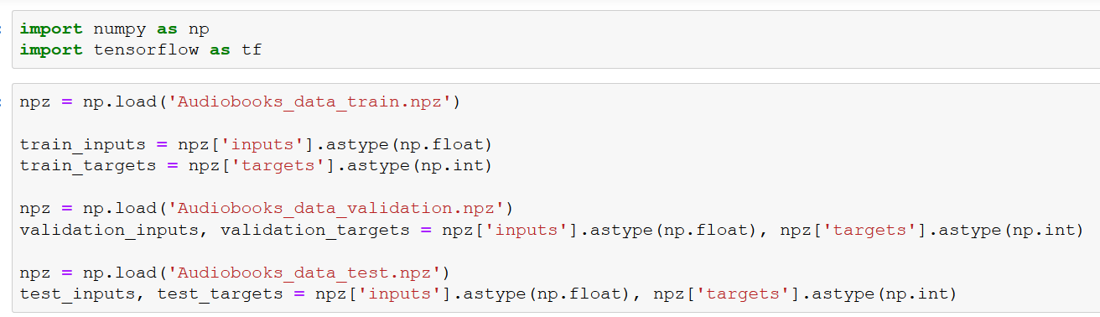
In a separate file, we work on the model:
Notes:
To ensure that they are all floats, let's also take care of that
Targets must be int because of sparse_categorical_crossentropy (we want to be able to smoothly one-hot encode them)
NOTE: .astype() creates a copy of the array and cast it to the specified type

Slide 31
For the model, we don’t need “flatten”, because the data has been processed already
The model will very likely overfit!
You need to set up an early stopping mechanism

Slide 32
There are a lot of interesting “callbacks” in TensorFlow, but here we need EarlyStopping
You can check here for other interesting features:
https://www.tensorflow.org/api_docs/python/tf/keras/callbacks

Slide 33
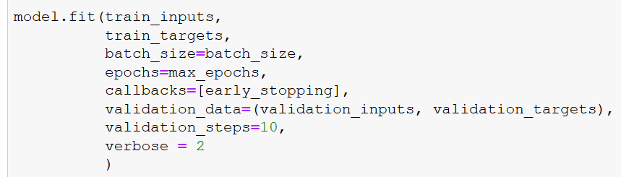
How many consecutive increases on the validation loss we want to tolerate

Slide 34
Following these slides, you need to build a machine learning model to predict future audiobooks purchases. Furthermore, fiddling with the parameters, you will try to reach the higher accuracy possible.
You can find the dataset for the business case on Canvas.
Remember that the dataset needs to be processed as shown in class. However, you can try other ways if you want. Be sure to shuffle the data, though. Also, don't overfit the model!
Submission:
In "Submission - Abstract", you will submit the maximum accuracy reached against the test set, plus a brief description of the hyperparameters used (hidden layers, number of nodes, activation functions, etc..).
In "Submission - Paper", you will submit an essay where you explain your reasoning and the performed tests.

